Slide 1





BY
Dr. Ashraf Mohamed El-Saghier
M.D. pediatrics
Disorders of The Respiratory System

Slide 2
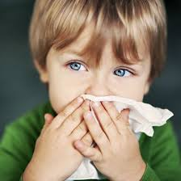
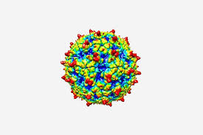
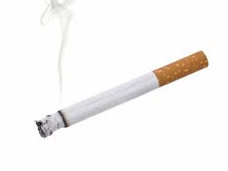
Common Cold
Common cold is the most frequently occurring illness in childhood. It is more common in autumn and winter.
ETlOLOGY:
More than 200 viruses can cause common cold e.g. rhinoviruses.
Predisposing factors:
Overcrowding, passive smoking and attending daycare sittings.

Slide 3
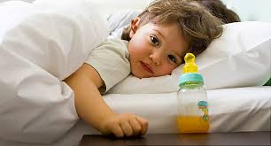
Common Cold
CLINICAL MANIFESTATIONS:
In infants
Fever, irritability.
Feeding and sleeping difficulties duo to nasal obstruction.
Cough which may lead to vomiting and mild diarrhea.
In older children
It starts with nasal irritation then nasal secretion, sneezing and sore throat.
Low grade fever, myalgia, headache, decreased appetite and cough.

Slide 4
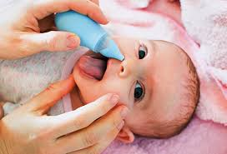

Common Cold
Complications:
Secondary bacterial infection.
Asthma may be triggered by common cold.
TREATMENT:
No specific treatment.
Acetaminophen or ibuprofen for fever.
Saline nasal drops.
No antibiotic is recommended.
High dose of vitamin C.

Slide 5
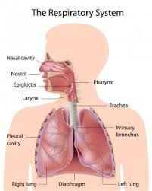
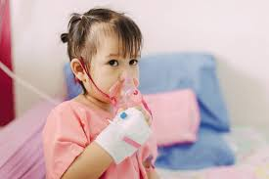
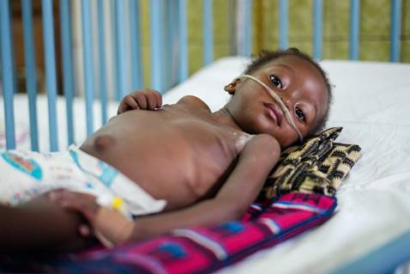
Pneumonias
Definition: Inflammation of the parenchyma of the lung.
It is the main cause of respiratory distress and hospital admissions.

Slide 6
Pneumonias
Classification:
I-Anatomical
1- Lobar pneumonia: inflammation Is localized one or more lobes of the lung. It is almost always due to bacteria. Usually unilateral.
2- Lobular pneumonia (bronchopneumonia): leads to patchy inflammation in the lungs. It is usually bilateral. It is bacterial or viral in origin.
3- Interstitial pneumonia: it is an inflammation of the interstitium of the lungs, usually bilateral, and mainly due to viral infection. Usually bilateral.

Slide 7
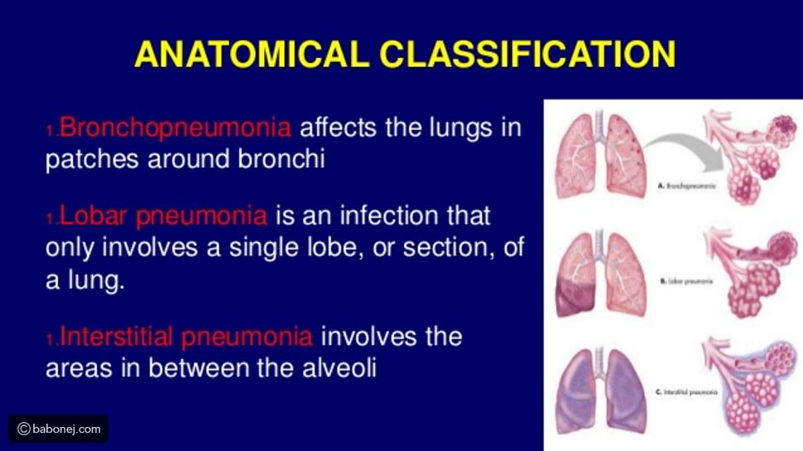
Pneumonias
Classification:

Slide 8
Pneumonias
II- Etiological classification:
1- Infectious: 90% of cases.
a- Bacterial: e.g. pneumococcus, hemophilus influenza, staphylococcus, and TB.
b- Viral: e.g. respiratory syncytial virus, influenza virus, and parainfluenza virus.
c- Protozoal
d- Mycotic (fungal)
2- Non Infectious: includes:
a- Aspiration pneumonia: e.g. aspiration of amniotic fluid and gastric contents.
b- Chemical pneumonia.

Slide 9
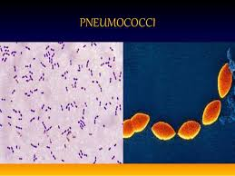
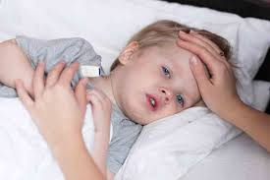
Pneumococcal pneumonia
Caused by streptococcus pneumoniae, it represents 90% of childhood bacterial pneumonia, and occurs mainly in winter and early spring.

Slide 10
Pneumococcal pneumonia
Clinical manifestations
After a brief mild upper respiratory infection, there is often onset of a shacking chill followed by fever as high as 40 C. this is accompanied by rapid respiration and manifestations of respiratory distress, dry cough and anxiety.
The child prefers to lie on the affected side to minimize chest pain and improve ventilation.

Slide 11
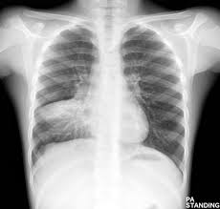
Pneumococcal pneumonia
Diagnosis:
1- Chest X-ray.
2- CBC: leukocytosis.
3- Isolation of the organism from secretions obtained by deep cough or tracheal aspiration.
4- Blood culture: bacteremia is found in 30% of patients.

Slide 12
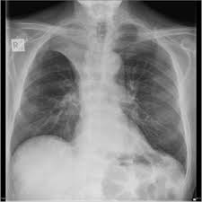
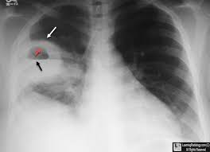
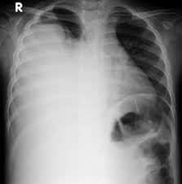
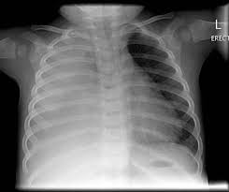
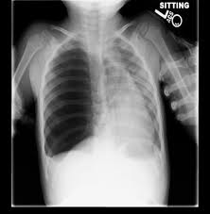
Pneumococcal pneumonia
Complications:
I- Pulmonary:
1- Lung Collapse
2- Lung abscess
3- Pleural effusion (fluid in the pleural space)
4- Empyema (pus in the pleural space)
5- Pneumothorax (air in the pleural space)
6- Respiratory failure
II- Extra Pulmonary complications:
1- Septicemia, meningitis, arthritis, osteomyelitis, and peritonitis
2- Heart failure.

Slide 13
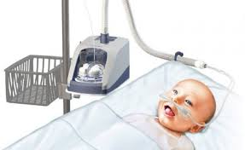

Pneumococcal pneumonia
Treatment:
Hospitalization is indicated in severe respiratory distress.
1- Antibiotics
2- Oxygen therapy
3- Symptomatic treatment e.g. antipyretics
4- Good nutrition
5- Oral zinc
6- Treatment of complications

Slide 14
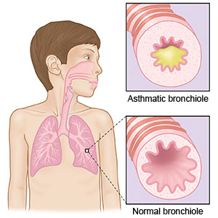
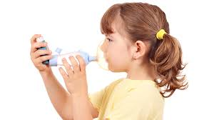
Bronchial Asthma
Definition: chronic inflammatory disease with diffuse and reversible bronchoconstriction in response to a variety of stimuli.
Etiology: asthma is usually a complex disorder involving immunologic, infectious, and psychologic factors.

Slide 15
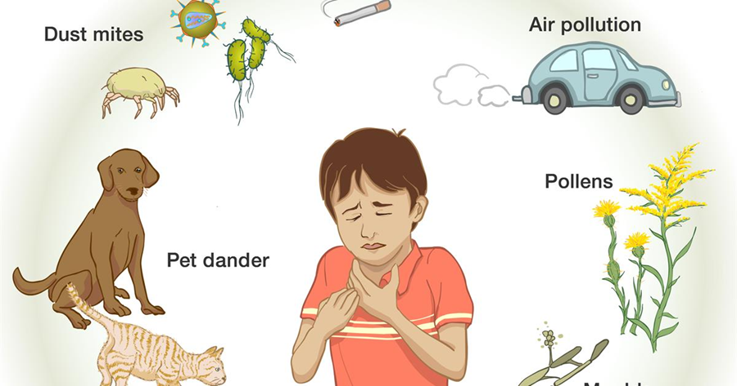
Bronchial Asthma
Asthma triggers:
1- Viral infection of the respiratory tract.
2- Animal dander
3- Dust mites
4- Pollens
5- Tobacco smoke
6- Air pollutants.
7- Strong odors e.g. perfumes

Slide 16
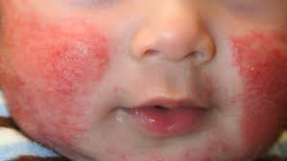
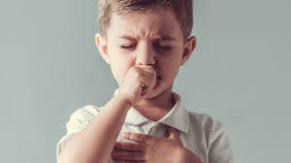
Bronchial Asthma
Clinical manifestations:
1- Intermittent dry cough and/ or wheeze are the most common Symptoms.
2- Shortness of breath.
3- Symptoms are worse at night
4- Other allergic conditions e.g. eczema

Slide 17
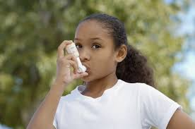
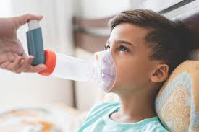
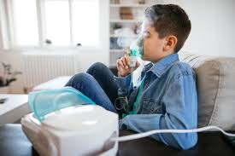
Bronchial Asthma
Diagnosis:
1- Clinical manifestations: recurrent episodes of cough and/ or Wheeze triggered by exercise, viral infection or inhaled allergens
2- + ve family history of asthma
3- Improvement after use of bronchodilators

Slide 18
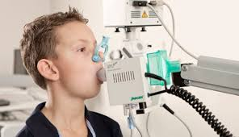
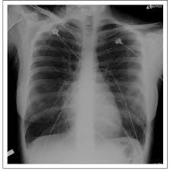
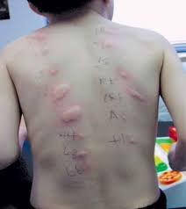
Bronchial Asthma
4- Investigations:
Pulmonary function test
Chest X-ray
Eosinophilia
Allergic skin tests may identify asthma triggers

Slide 19


Bronchial Asthma
Treatment:
1- Quick relief medications (relievers): are taken on occurrence of the attack usually by inhalation e.g. salbutamol
2- Long-term control medications (controllers): are taken by inhalation or orally e.g. steroids and theophylline.

Slide 20


